Slide 1

Blazor
Client-Side Web UI With .NET Core 3.0

Slide 2



Blazor
Free and open-source web framework by Microsoft
C# + HTML
5 different editions

Slide 3
Blazor Server
Hosted on ASP.NET Core server
Razor format
Clients act like thin clients - SignalR
Processing load is on server
No offline support
Released as a part of .NET Core 3 (2019-09-23)

Slide 4
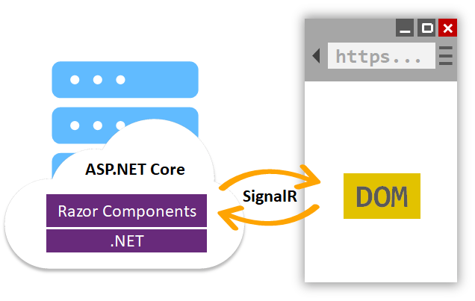
Blazor Server

Slide 5
Blazor WebAssembly
Single page app downloaded to the client’s web browser
Larger initial download than web Blazor Server app
Processing is entirely done on the client HW
Rapid response time
Restrictions because of WASM
Availability scheduled for May 2020

Slide 6
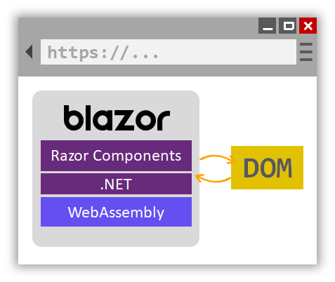
Blazor WebAssembly

Slide 7
Other planned editions
Blazor PWA
Supports Progressive Web Apps
Blazor Hybrid
Platform native framework
Renders the UI using web technologies (HTML + CSS)
Blazor Native
Platform native framework
Renders platform native UI

Slide 8
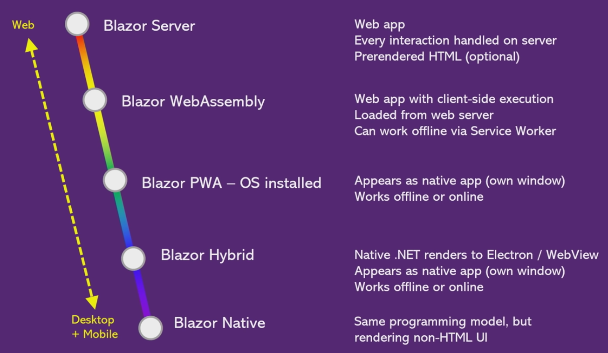

Slide 9
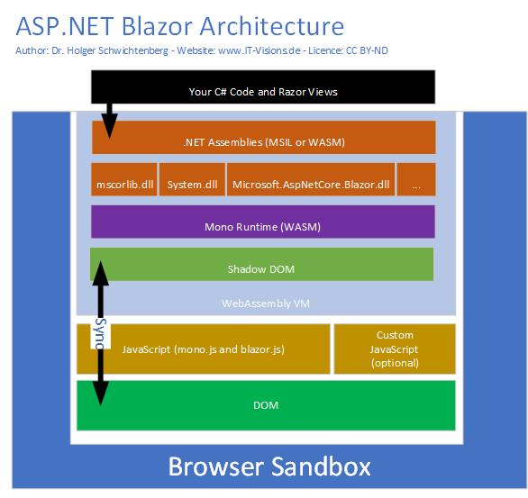

Slide 10


Slide 11

WebAssembly
Binary instruction format for a stack based VM
Portable compilation target for high level languages like C/C++/Rust
Open Standard
Performance
Safe

Slide 12
WebAssembly
Very different from .NET IL
Much simpler
Linear memory
No GC
support for just 4 types - all numeric
No direct DOM or WebAPIs access (yet)
JavaScript interop exists

Slide 13

WebAssembly + CLR
C++ can be compiled into WASM
The .NET CLR is written in C++
.NET CLR can run on WASM with Mono

Slide 14
Rendering
does not bring its own rendering (like Silverlight)
uses the Browser’s DOM to display data
C# code running in WebAssembly cannot access the DOM directly, but through JavaScript

Slide 15
Rendering
C#
JavaScript
DOM
Render Tree
Change DOM
Process event
User trigger event (e.g. click)
Event
UI differences
Change DOM
C#
JavaScript
DOM

Slide 16
Comparison
JS-based Frameworks
TypeScript/JavaScript
Huge ecosystem of tools and components
Mature
Feature-richness
Proven for small & large projects
Web development skills necessary
No reuse of C# code possible
Blazor
C# and JavaScript/TypeScript
Limited community
Immature tools
Limited functionality
(B)Leading Edge
Maturity of C#/.NET
Less web development skills necessary
Reuse of C# code possible

Slide 17
Demo
Lets see come code

Slide 18


Slide 19

Concern: Older browsers

Slide 20

Concern: Downloading .NET runtime in browser?

Slide 21

Concern: Do you remember?

Slide 22

Use it in production?

Slide 23
Questions
Don’t hesitate

Slide 24


